Slide 1
Walmart Sales Analysis

Slide 2
Brief overview:- the provided Walmart sales dataset contains transaction details across multiple branches, capturing key sales metrics and customer information. Below are the primary features of the dataset.

Slide 3
KEY COLUMNS IN THE DATASET:-
. Invoice ID: Unique identifier for each transactions
. Branch: The store branch where the transaction took place
. City: City corresponding to the branch location
. Customer type: Categorizes customers as either Member or Normal
. Gender: Customer gender
. Product line : Specifies the type of product purchased
. Unit Price: Price per unit of the purchased item
. Quantity: Number of items purchased in transaction
. Tax 5%: The 5% tax calculated on total purchase
. Total: The final amount paid, including tax
. Date: The date of Transaction
.Time: The time transaction Occurred
. Payment: Payment method used
. Cogs(Cost Of Good Sold): The direct cost of producing the goods sold
. Gross Income: The Calculated profit for the transaction
. Gross Margin Percentage: The profit margin percentage
. Rating: Customer satisfaction rating
. Customer id: Unique identifier for each customer

Slide 4
DATA CHARACTERISTICS:-
.Time Frame: The dataset covers transactions from January to March 2019.
. Geographical Scope: Transactions are recorded across three key cities: Yangon, Naypyitaw and Mandalay
. Sales pattern: Captures a variety of product categories and payment methods to reflect customer preferences
Potential Insights:-
. Sales trends and growth rates.
. Customer behaviour and segmentation
. Profitability across product lines
. Transaction timing pattern.

Slide 5
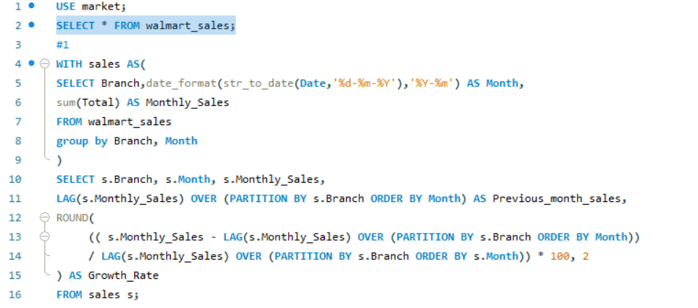
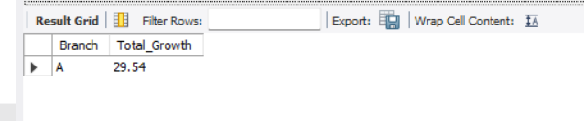
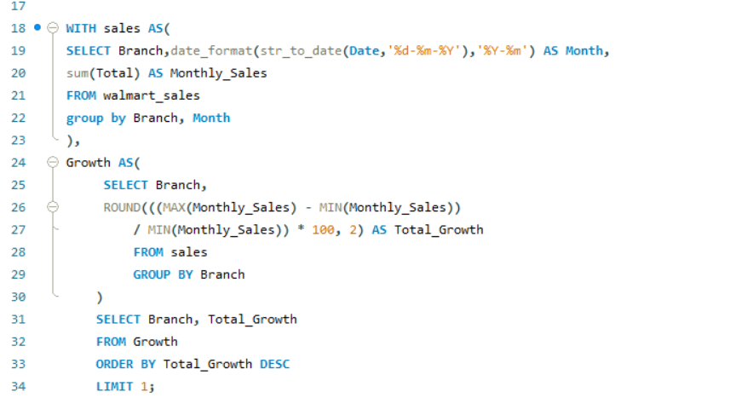
TASK 1: Identifying the Top Branch by Sales Growth Rate
Result:

Slide 6
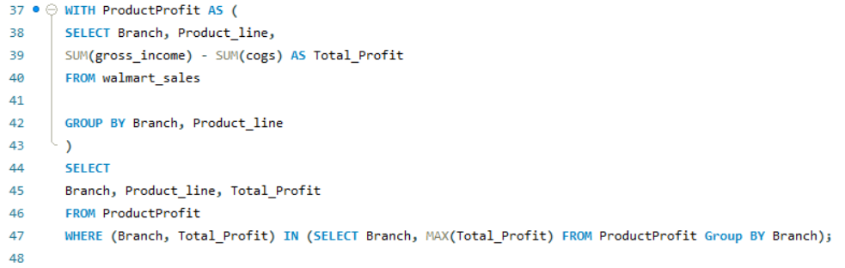
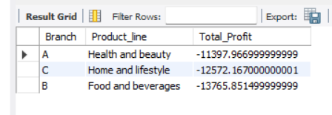
TASK 2: Finding the Most Profitable Product Line for Each Branch
RESULT:

Slide 7
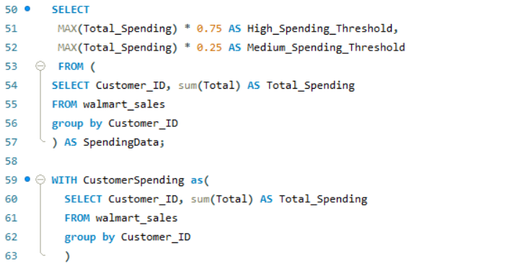
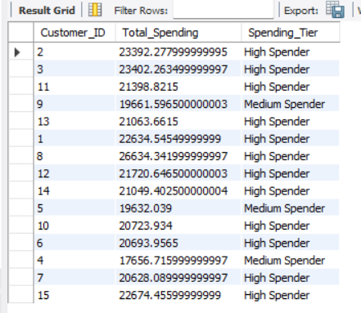
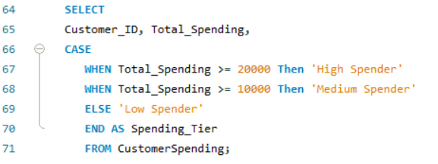
TASK 3: High Spenders : Ideal for exclusive offers and VIP programs
Medium Spenders : Can be encouraged to spend more through
targeted promotions
Low Spender : Could benefit from discounts
RESULT:

Slide 8
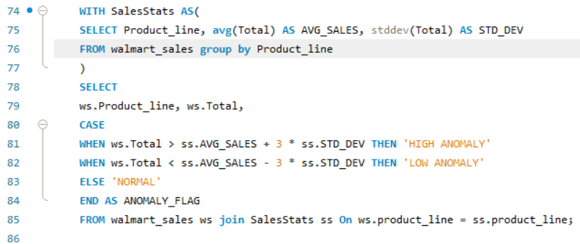
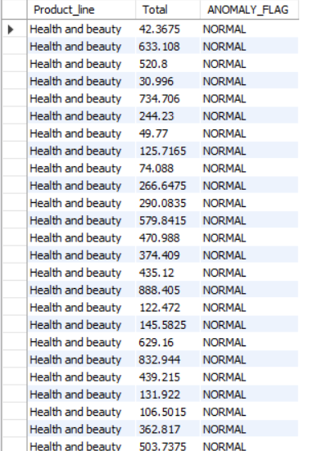
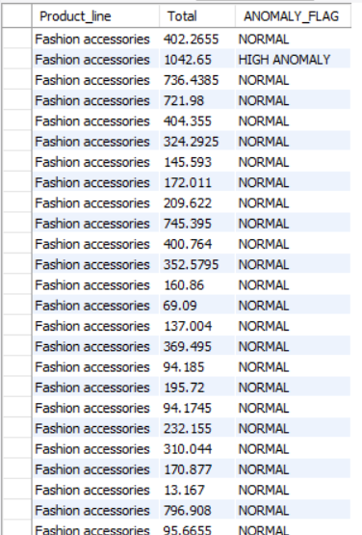
TASK 4: Identifying Sales Anomalies RESULT:
Insights: Some transactions in Fashion accessories have
high anomaly. This indicates bulk purchases, special
order or may be data entry error.
RESULT:

Slide 9
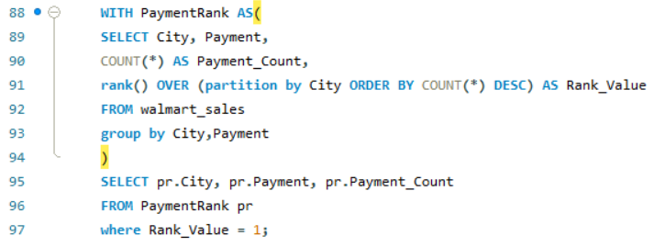
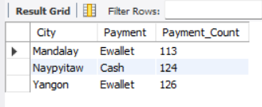
TASK: 5 Most Popular Payment Method by City
Result:

Slide 10
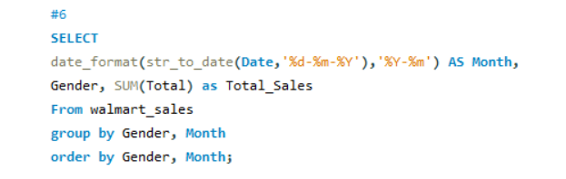
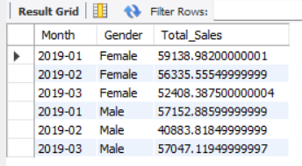
TASK 6: Monthly Sales Distribution BY Gender
Result:

Slide 11
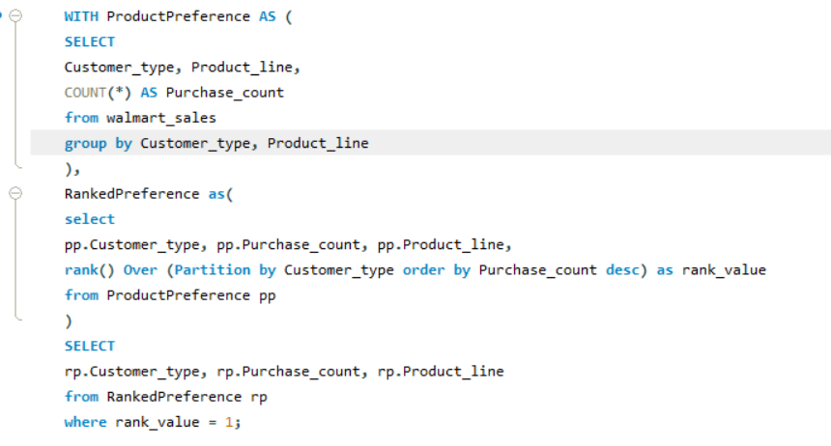
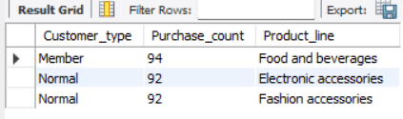
TASK: 7 Best Product Line by Customer Type
Result:

Slide 12
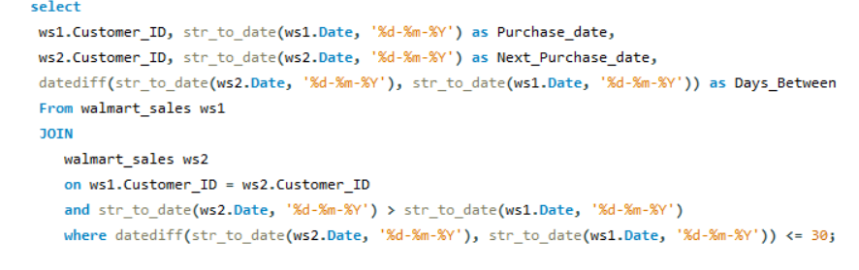
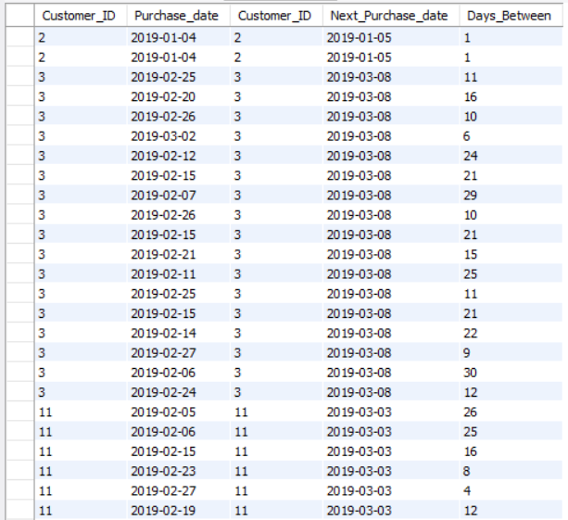
TASK 8: Identifying Repeat Customers
Result :

Slide 13
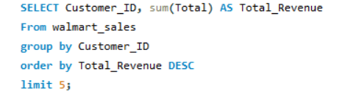
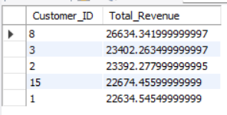
TASK 9: Finding Top 5 Customers By Sales Volume
Result:

Slide 14
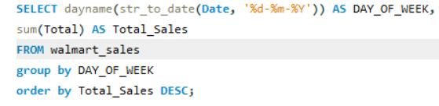
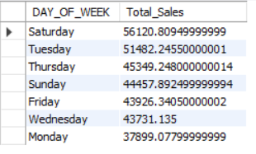
TASK 10: Analysing Sales Trends BY Day of the week
Result:

Slide 15
KEY POINTS:-
Implement targeted promotions based on customer type, city and payment preference.
Introduce loyalty programs for high spenders and repeat customers.
Investigate identified anomalies to improve data accuracy and transaction.
Schedule strategic marketing campaigns to capitalize on peak sales days like Saturday
Focus on strengthening profitable product lines while expanding offering in underperforming categories.
Link for the recorded video explanation:
https://drive.google.com/file/d/1pJWC4s_As28W55RwRLHtVyyyTLPxrXhK/view?usp=sharing

